Slide 1
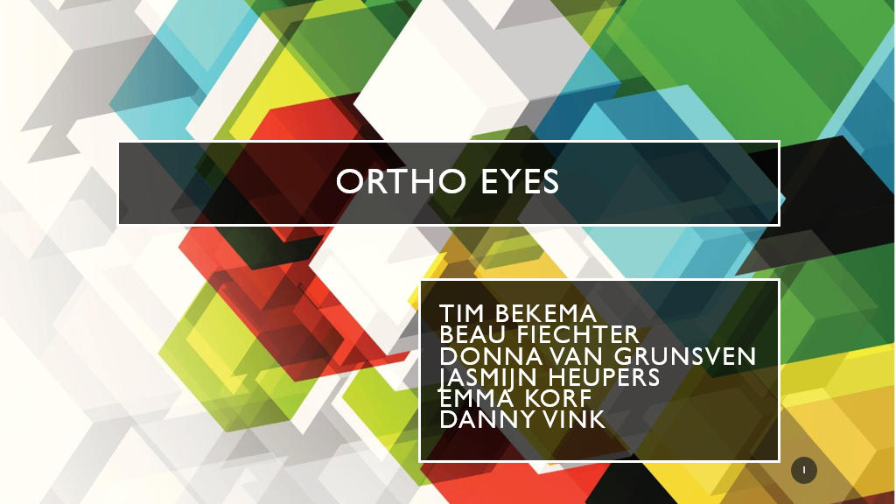

Slide 2
Table of contents
Our project
Progress since last week
Planning for this week
Questions

Slide 3
Our project
Improve the OR-ensemble by achieving a higher recall and accuracy
Classifying people as control group or by severity of shoulder injury
Main question:
Which models can be added to the current OR-ensemble to further improve the ability to properly identify individuals as part of the correct patient group, using the existing data gained from a Flock of Birds system?

Slide 4
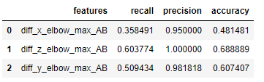
Progress
Gathering promising features
Analysing these features
Seem insightful? Test contribution in an experiment
Most features are tested in relevance and results are documented
Example: difference in max height between left and right elbow
Precision is 1.0, rest of results are promising

Slide 5
Planning
Meeting with project owner (Jurriaan de Groot)
Possibly continue with the rotation matrices
Adding features with worthwhile results to the original ensemble (like the example in slide 4)
Write explanations as to why which results are seen and what parameters are combined leading to these results

Slide 6
Questions
Thanks for listening!
Are there any questions?

